Slide 1
LAB 1 | LINUX UBUNTU INSTALL

Slide 2
Overview
Download the Ubuntu Linux Distribution
Create the Linux virtual machine on Virtual Box
Ensure that it is the latest version of Ubuntu (24.10)

Slide 3
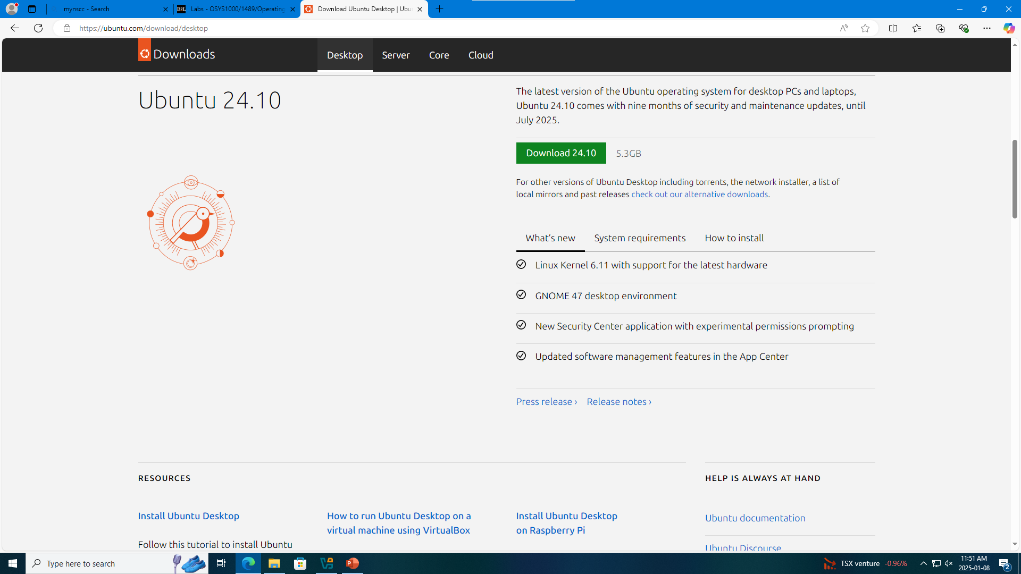
Download the Latest version of Ubuntu (24.10)

Slide 4
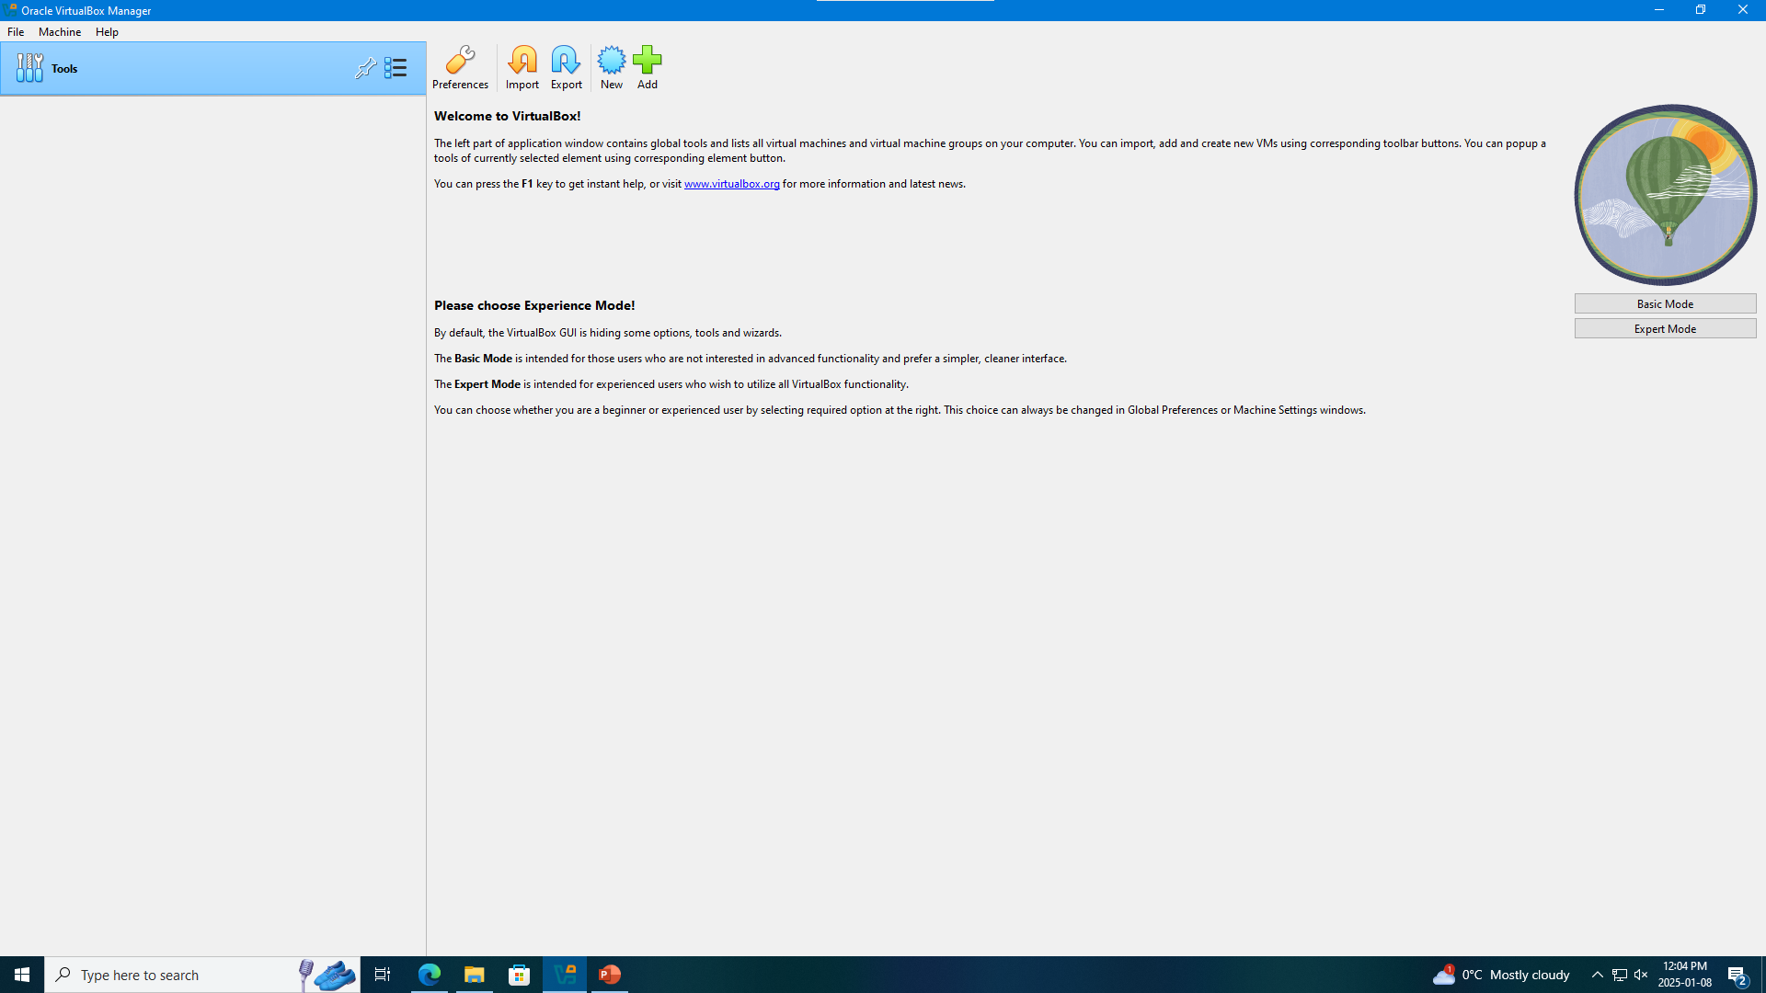
Open the Virtual Box

Slide 5
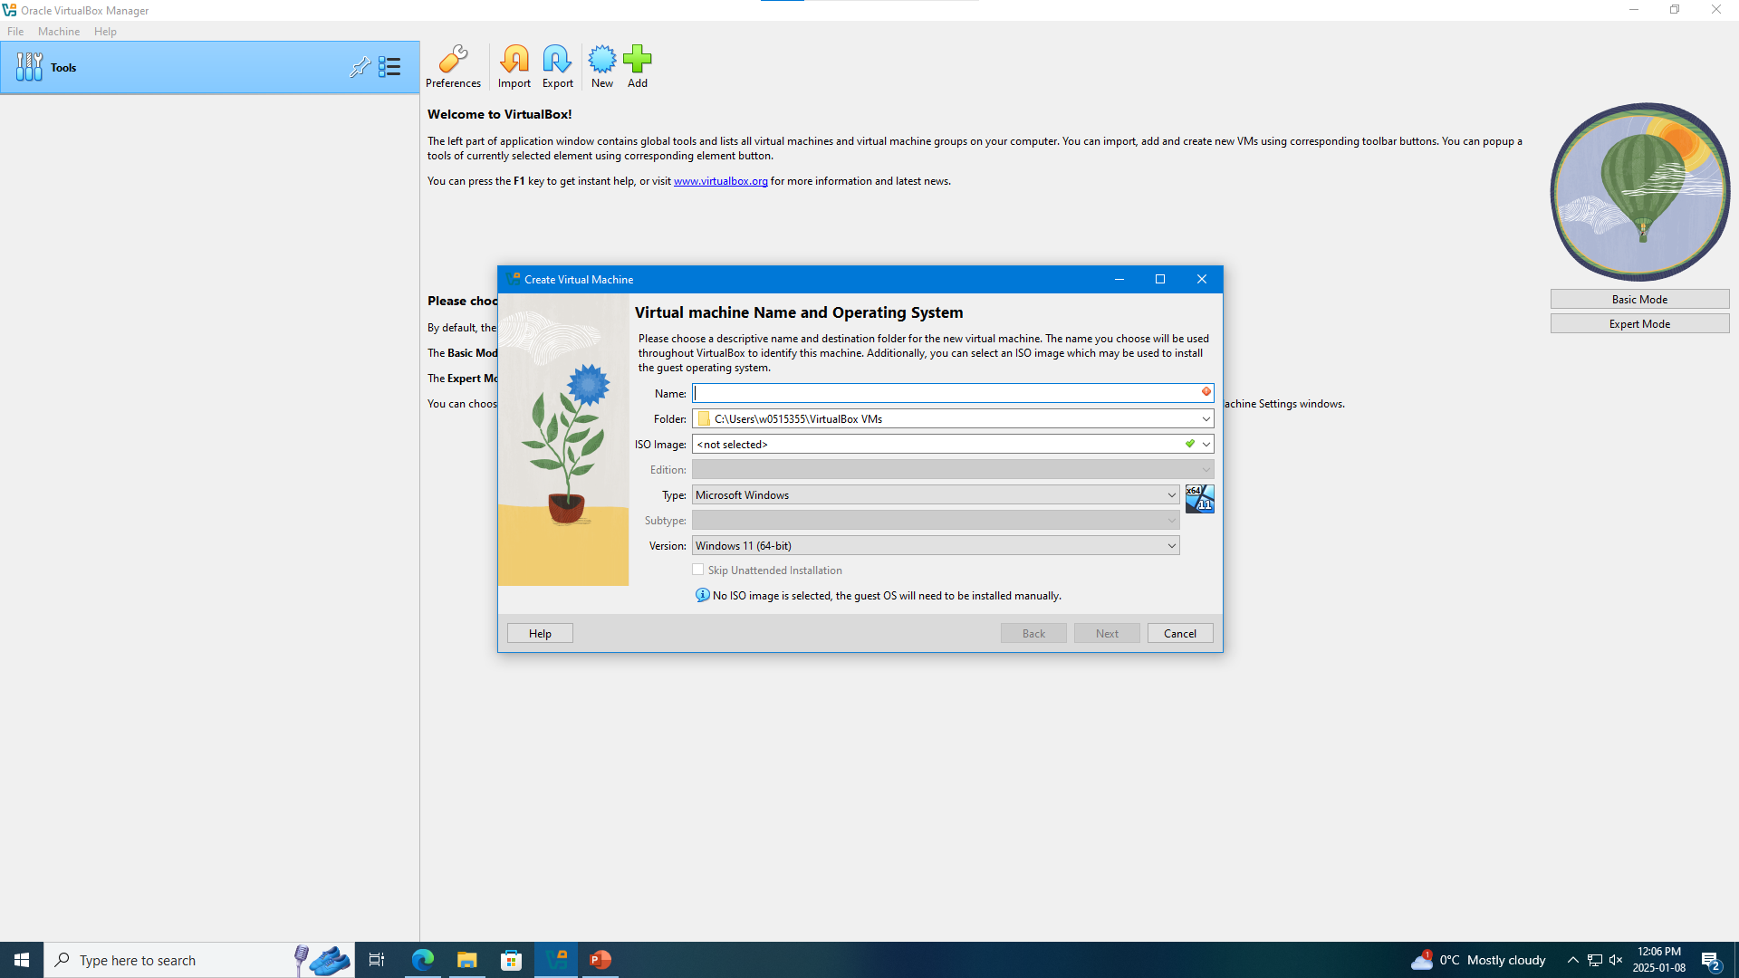
Click New

Slide 6
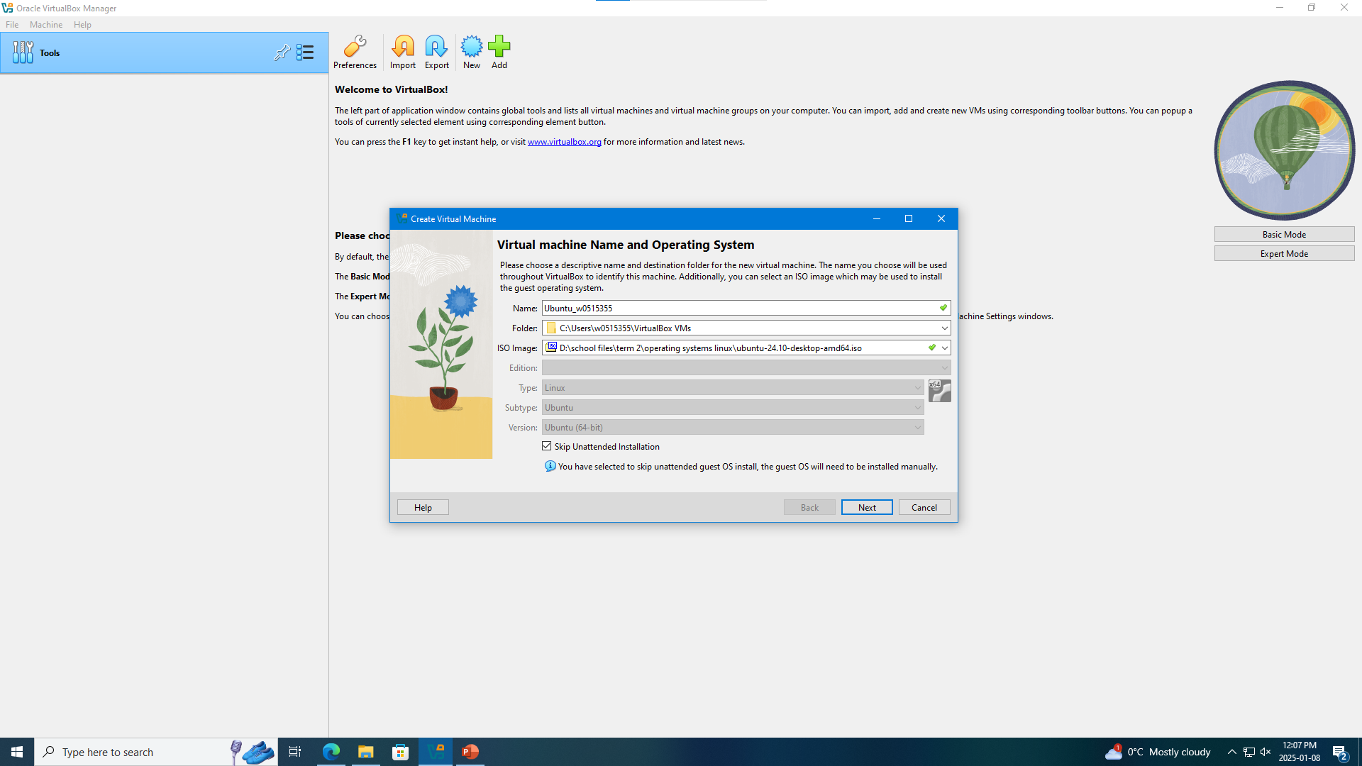
Create the Linux virtual machine on Virtual Box

Slide 7
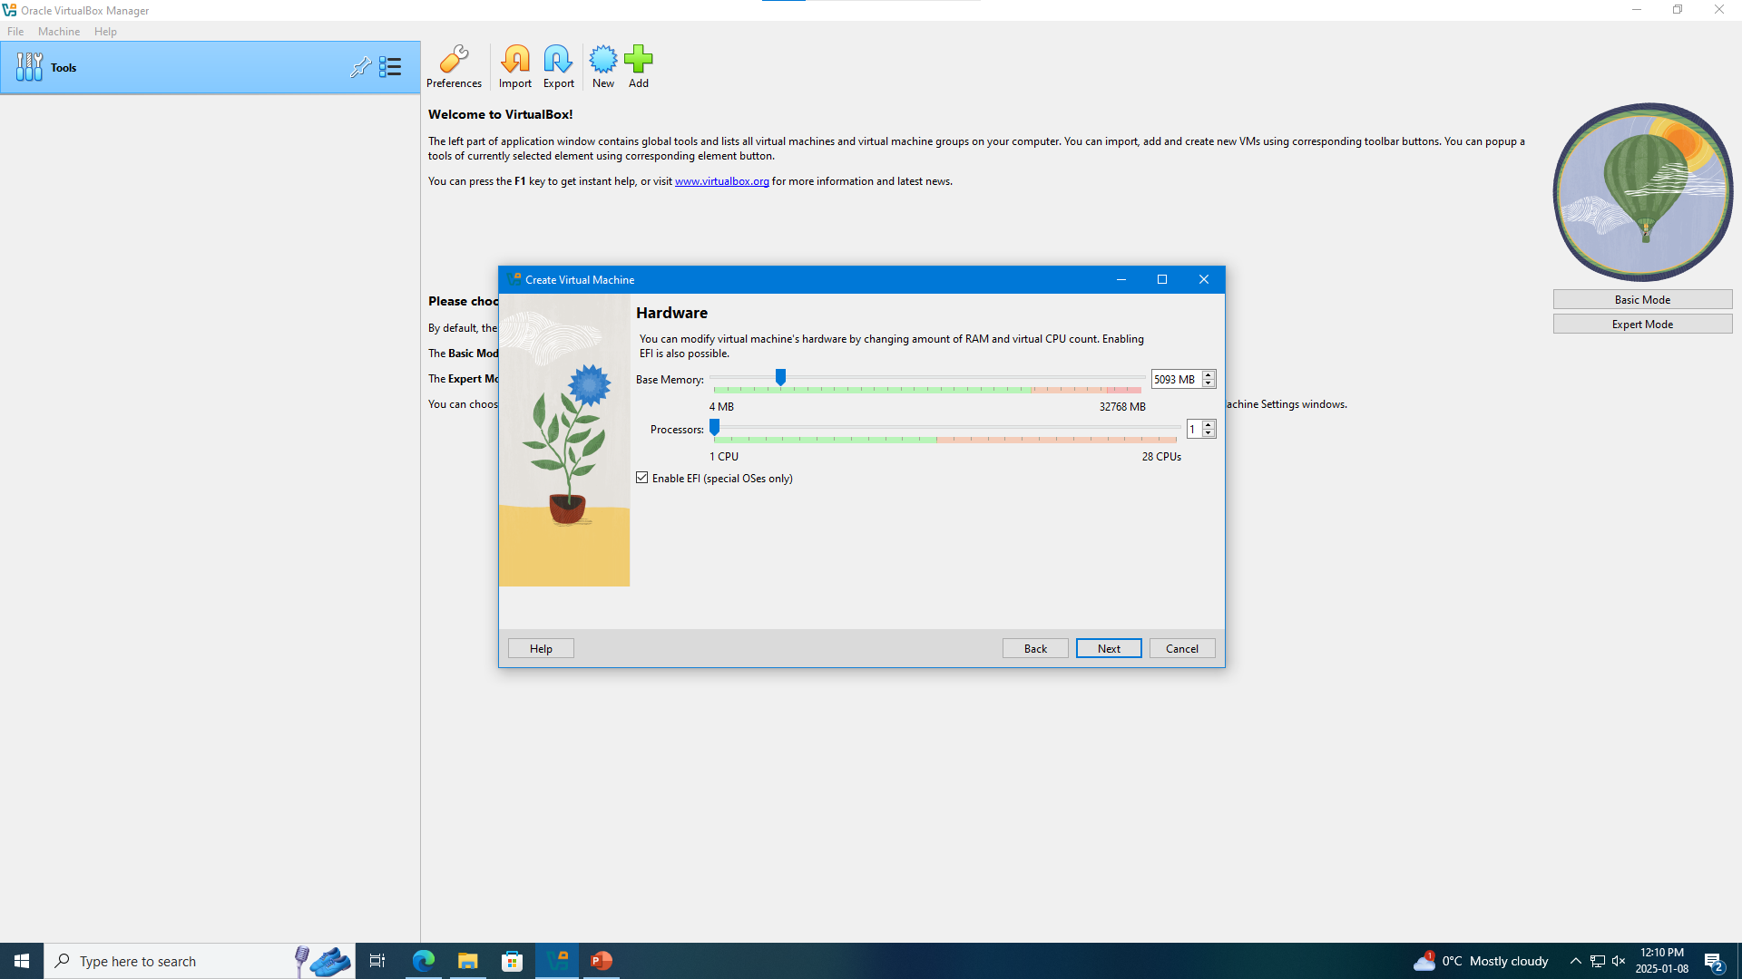
Click Next and modify your preferred RAM and CPU count.

Slide 8

Click Next

Slide 9
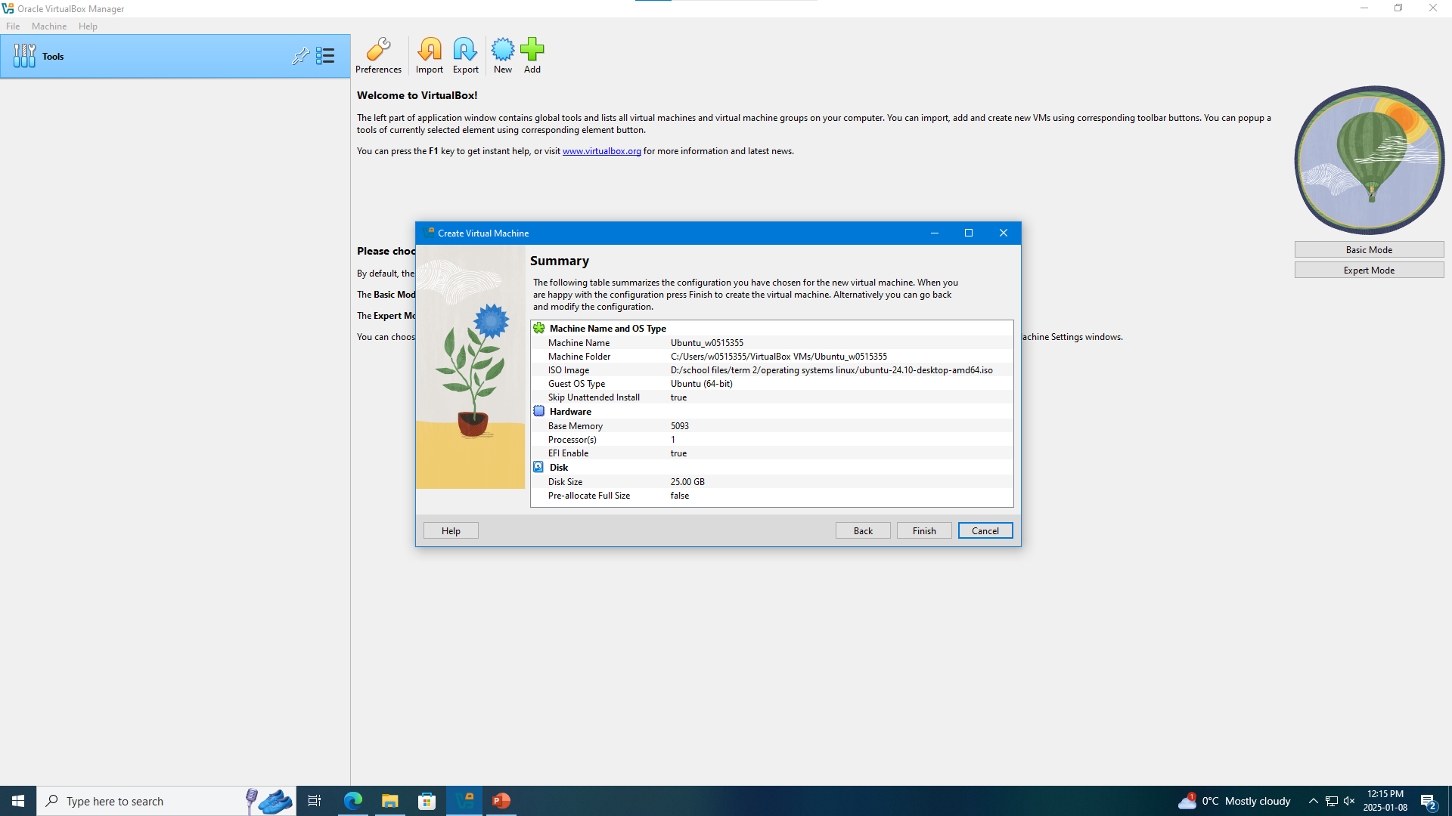
Click Finish

Slide 10
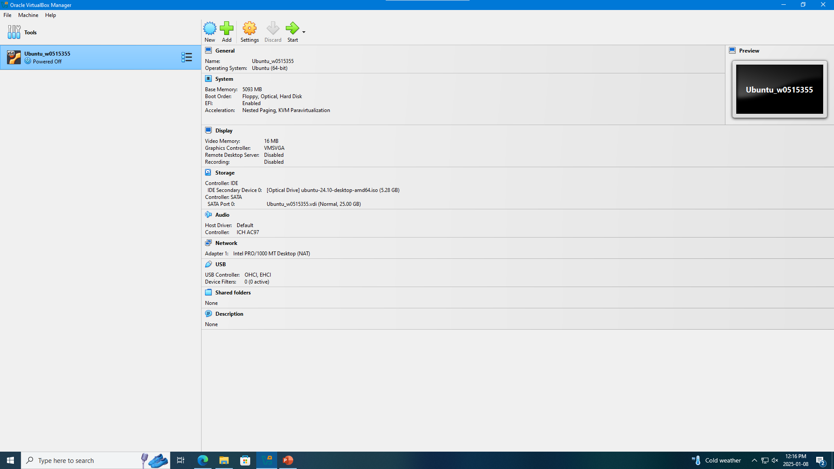
Click Start

Slide 11
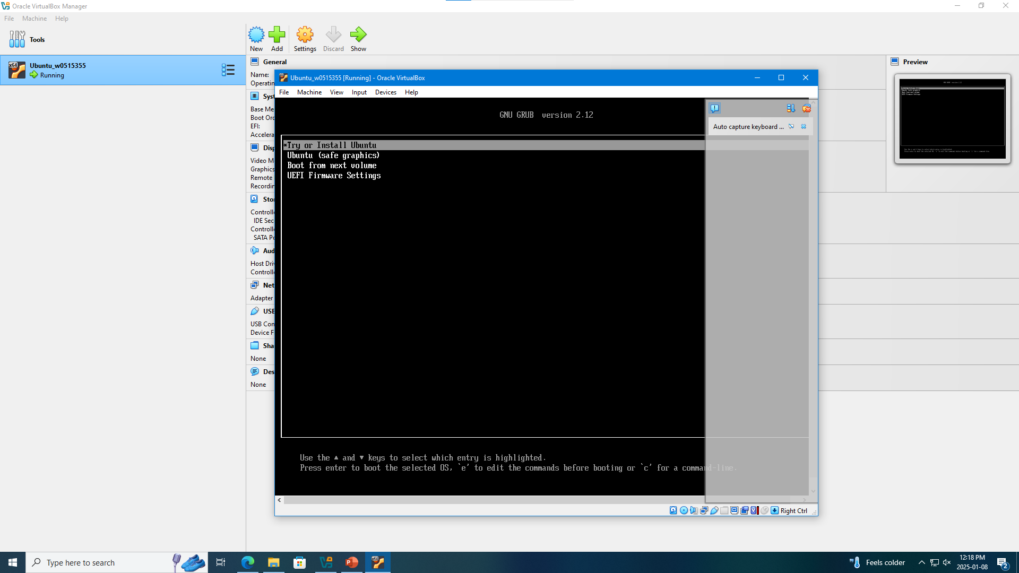
Click the Try or Install

Slide 12
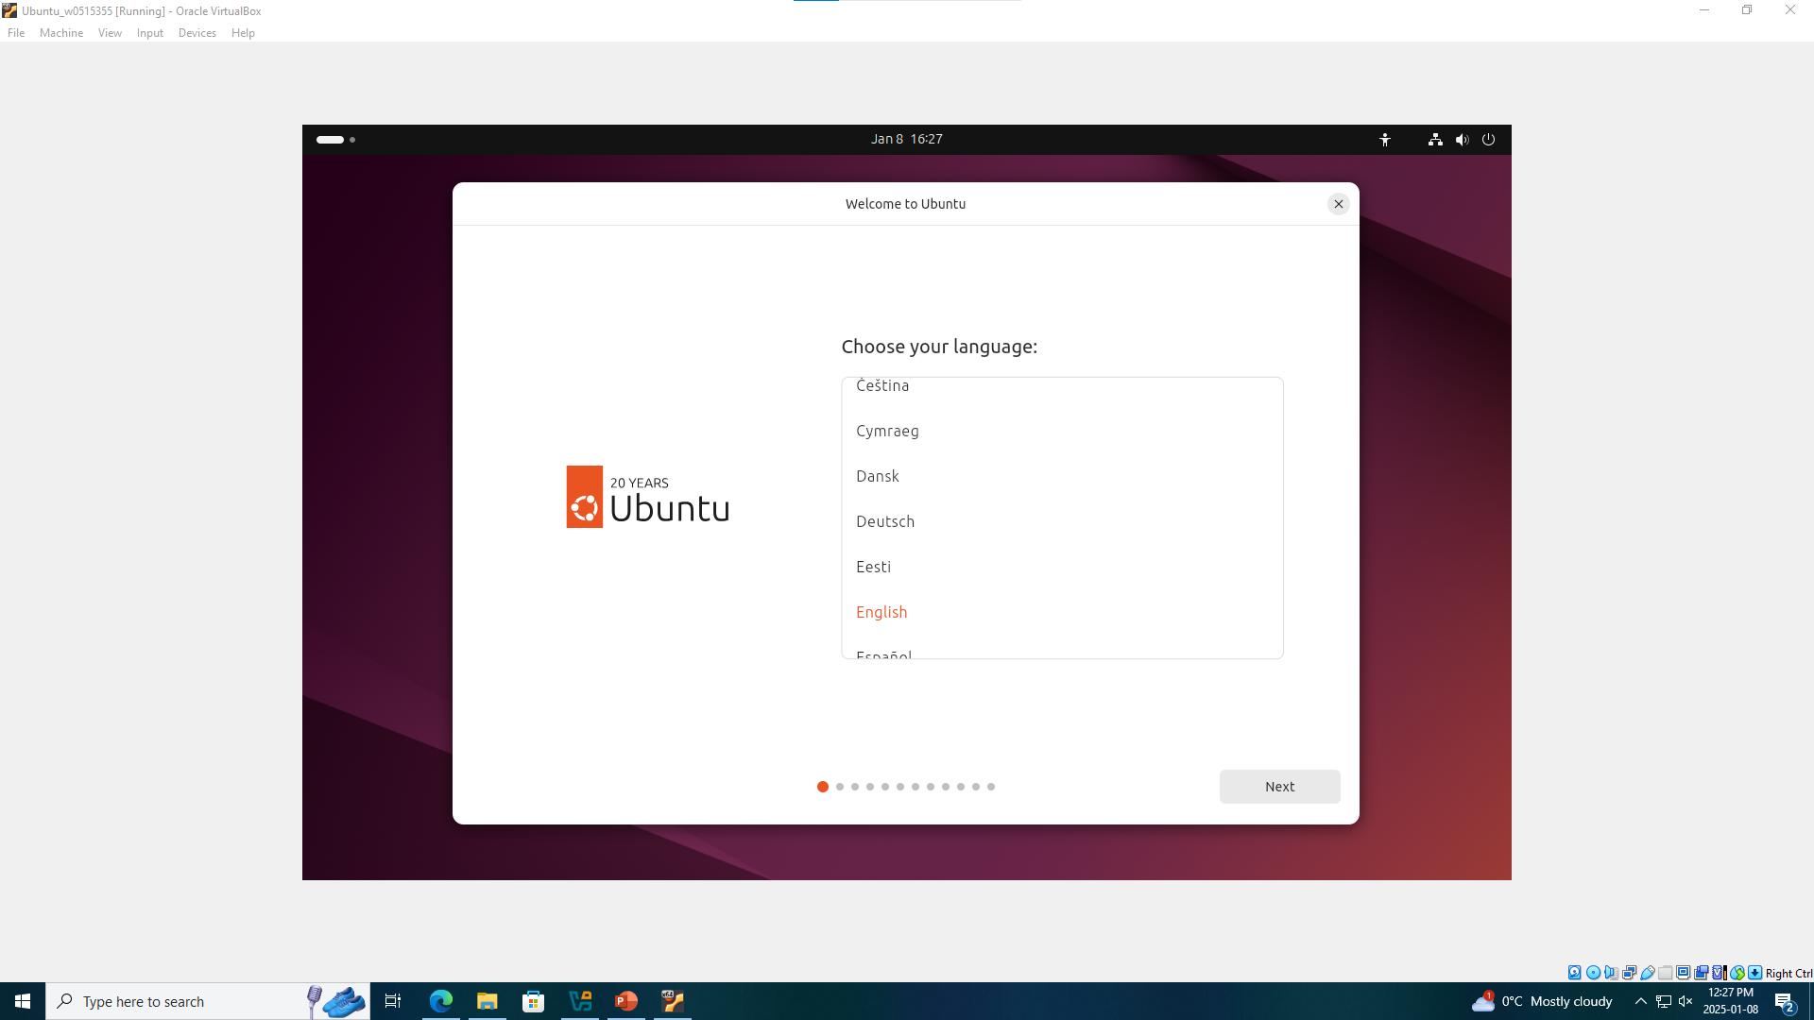
Wait for it to load and select language

Slide 13
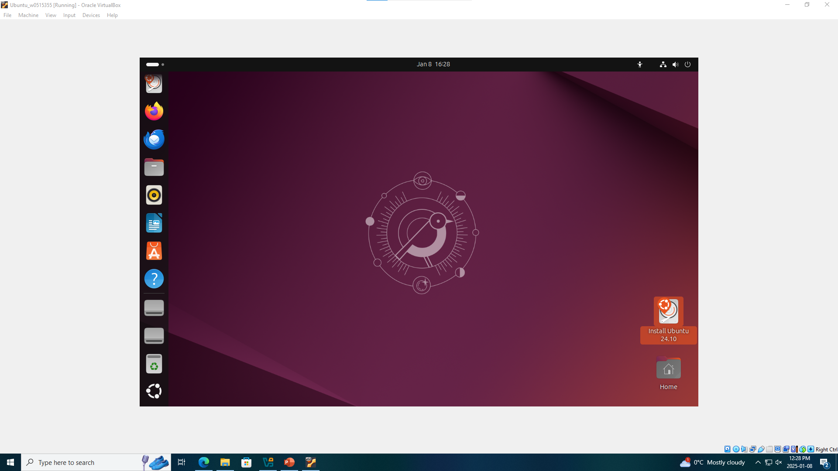
This is the Home Screen of Ubuntu, You can also create your account if needed

Slide 14
Thank you

